Slide 1

L4.2 Adversarial Robustness
Zonghua Gu 2021
Based on ICML 2018 tutorial https://adversarial-ml-tutorial.org

Slide 2
Outline
Introduction
Adversarial examples and verification
Constructing adversarial examples via local search
Physically-realizable attacks
Formal verification via combinatorial optimization
Formal verification via convex relaxations
Training adversarially robust models
Adversarial robustness beyond security

Slide 3
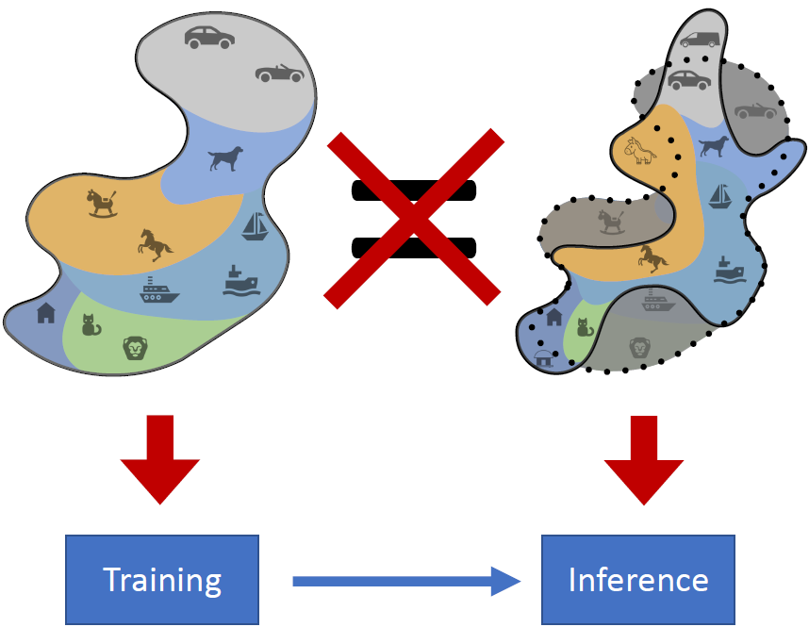
A Limitation of the (Supervised) ML Framework
Distribution Shift: In reality, the data distributions during inference on may NOT be the same as the ones we train it on
May be naturally occurring, or may be due to adversarial attacks

Slide 4
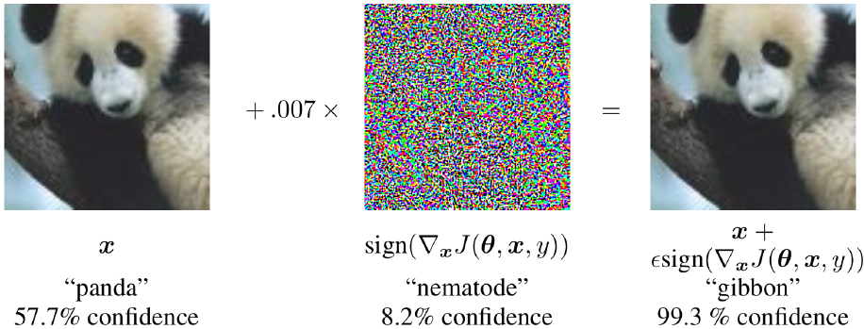
Adversarial Examples
Starting with an image of a panda, the attacker adds a small perturbation that has been calculated to make the image be recognized as a gibbon with high confidence.
https://openai.com/blog/adversarial-example-research/

Slide 5
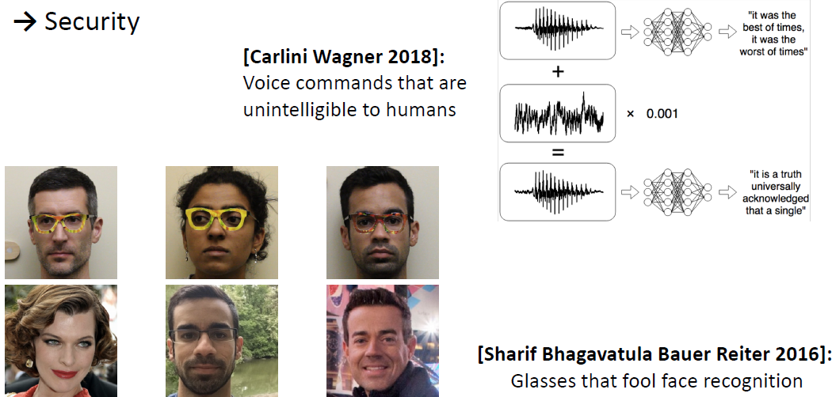
Why Is This Brittleness of ML a Problem?

Slide 6
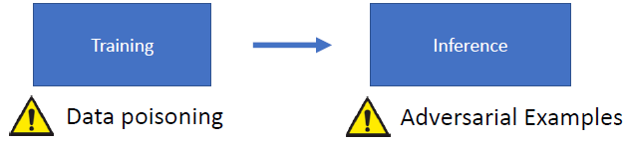
Training Time Attack vs. Inference Time Attack

Slide 7
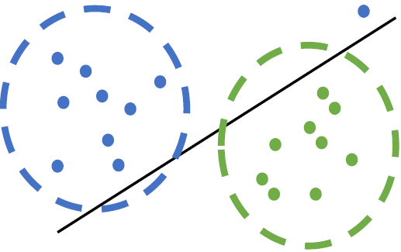
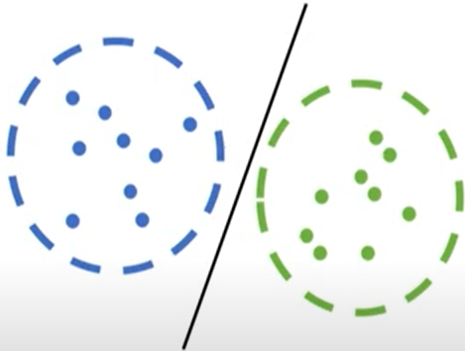
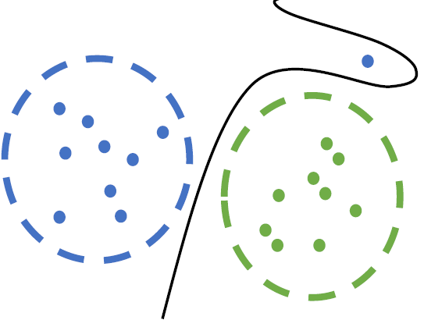
Data Poisoning
Adding a single “poison data point” may hamper a linear model’s generalization, but not for deep learning, which can handle outliers w. memorization
Data poisoning for
a linear model
Data poisoning for
deep learning
Notes:
Goal: Maintain training accuracy but hamper generalization

Slide 8
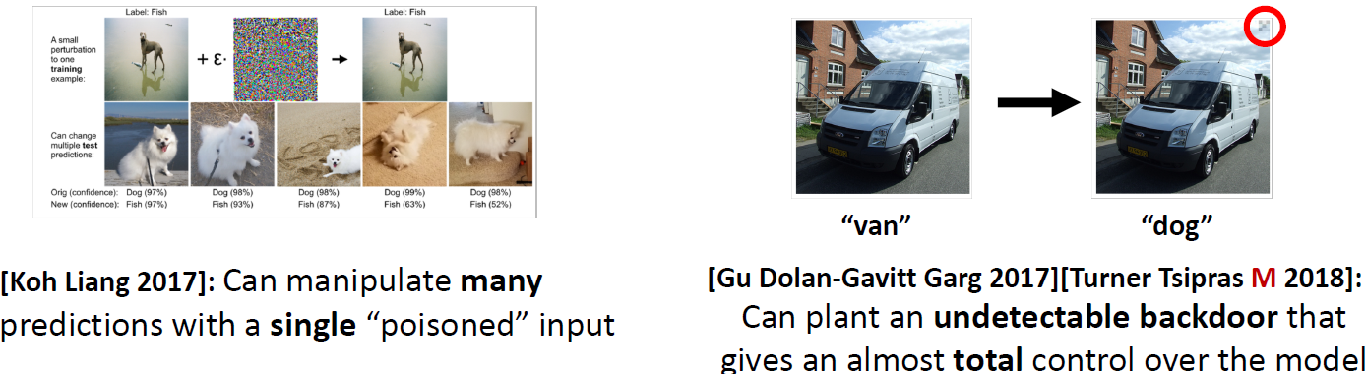
Data Poisoning for Deep Learning
But for deep learning, it may affect classification of specific inputs

Slide 9
Three Commandments of Secure/Safe ML
I. Thou shall not train on data you don’t fully trust
(because of data poisoning)
II. Thou shall not let anyone use your model (or observe its outputs) unless you completely trust them
(because of model stealing and black box attacks)
III. Thou shall not fully trust the predictions of your model
(because of adversarial examples)

Slide 10
Outline
Introduction
Adversarial examples and verification
Constructing adversarial examples via local search
Physically-realizable attacks
Formal verification via combinatorial optimization
Formal verification via convex relaxations
Training adversarially robust models
Adversarial robustness beyond security

Slide 11
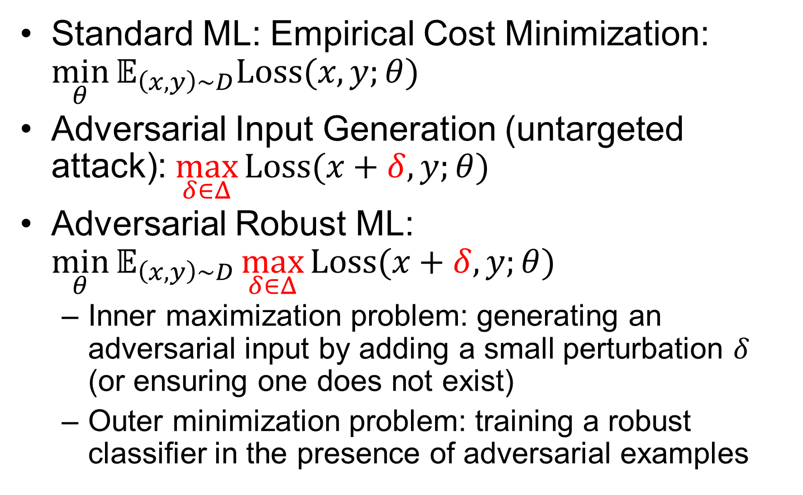
Robust ML Problem Formulation
Standard ML: Empirical Cost Minimization: $\min_{θ}{𝔼_{\left(x,y\right)∼D}Loss(x,y;θ)}$
Adversarial Input Generation (untargeted attack): $\max_{δ∈Δ}{Loss(x+δ,y;θ)}$
Adversarial Robust ML: $\min_{θ}{𝔼_{\left(x,y\right)∼D}\max_{δ∈Δ}{Loss(x+δ,y;θ)}}$
Inner maximization problem: generating an adversarial input by adding a small perturbation $δ$ (or ensuring one does not exist)
Outer minimization problem: training a robust classifier in the presence of adversarial examples

Slide 12
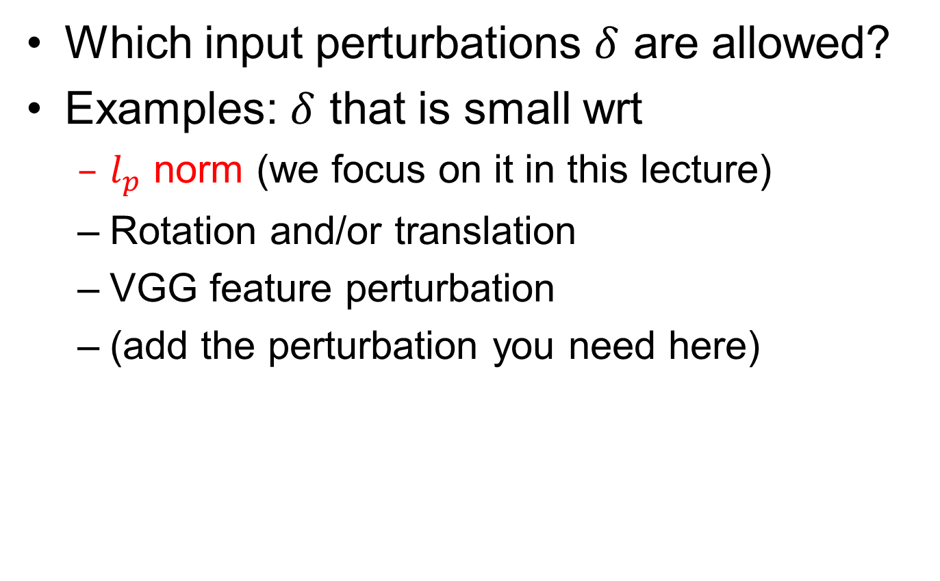
Input Perturbations
Which input perturbations $δ$ are allowed?
Examples: $δ$ that is small wrt
$l_{p}$ norm (we focus on it in this lecture)
Rotation and/or translation
VGG feature perturbation
(add the perturbation you need here)

Slide 13
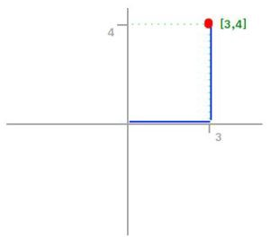
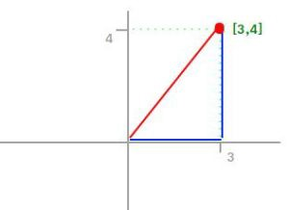
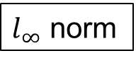
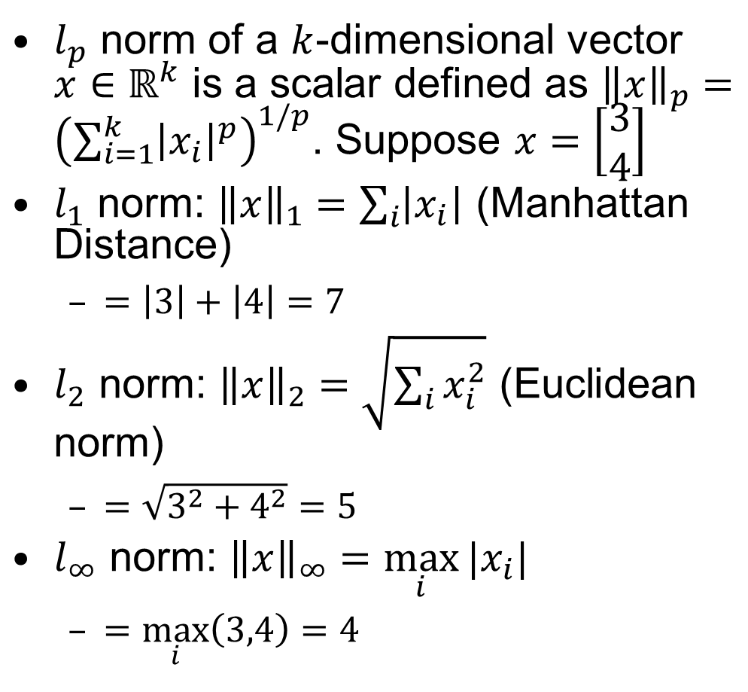
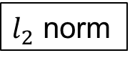
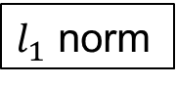
Vector Norms
$l_{p}$ norm of a $k$-dimensional vector $x∈ℝ^{k}$ is a scalar defined as ${\left\|x\right\|}_{p}={\left(\sum_{i=1}^{k}{{\left|x_{i}\right|}^{p}}\right)}^{1/p}$. Suppose $x=\left[\begin{matrix}3 \\ 4\end{matrix}\right]$
$l_{1}$ norm: ${\left\|x\right\|}_{1}=\sum_{i}{\left|x_{i}\right|}$ (Manhattan Distance)
$=\left|3\right|+\left|4\right|=7$
$l_{2}$ norm: ${\left\|x\right\|}_{2}=\sqrt{\sum_{i}{x_{i}^{2}}}$ (Euclidean norm)
$=\sqrt{3^{2}+4^{2}}=5$
$l_{∞}$ norm: ${\left\|x\right\|}_{∞}=\max_{i}{|x_{i}|}$
$=\max_{i}\left(3,4\right)=4$
$l_{1}$ norm
$l_{2}$ norm
$l_{∞}$ norm
https://montjoile.medium.com/l0-norm-l1-norm-l2-norm-l-infinity-norm-7a7d18a4f40c

Slide 14
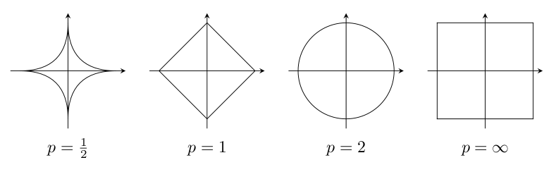
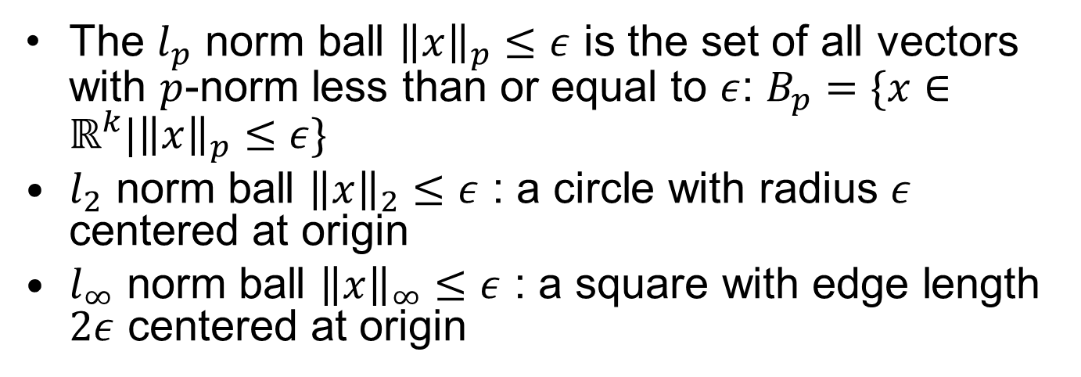
Vector Norm Balls
The $l_{p}$ norm ball ${\left\|x\right\|}_{p}≤ε$ is the set of all vectors with $p$-norm less than or equal to $ε$: $B_{p}=\{x∈ℝ^{k}|{\left\|x\right\|}_{p}≤ε\}$
$l_{2}$ norm ball ${\left\|x\right\|}_{2}≤ε$ : a circle with radius $ε$ centered at origin
$l_{∞}$ norm ball ${\left\|x\right\|}_{∞}≤ε$ : a square with edge length $2ε$ centered at origin
Notes:
https://math.stackexchange.com/questions/2966181/is-vert-x-vert-hm-omega-1-sobolev-norms-always-a-unit-ball-if-you-p

Slide 15
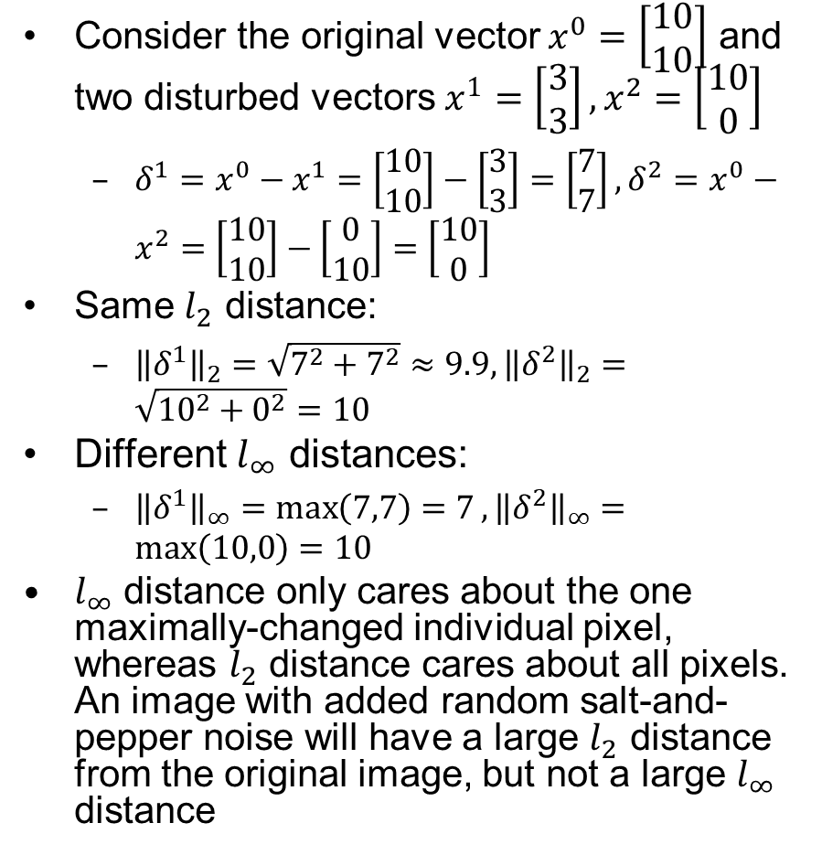

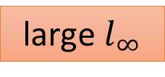
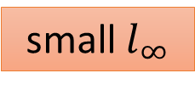
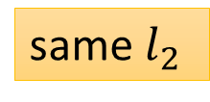
$l_{2}$ vs. $l_{∞}$
Consider the original vector $x^{0}=\left[\begin{matrix}10 \\ 10\end{matrix}\right]$ and two disturbed vectors $x^{1}=\left[\begin{matrix}3 \\ 3\end{matrix}\right],x^{2}=\left[\begin{matrix}10 \\ 0\end{matrix}\right]$
$δ^{1}=x^{0}−x^{1}=\left[\begin{matrix}10 \\ 10\end{matrix}\right]−\left[\begin{matrix}3 \\ 3\end{matrix}\right]=\left[\begin{matrix}7 \\ 7\end{matrix}\right],δ^{2}=x^{0}−x^{2}=\left[\begin{matrix}10 \\ 10\end{matrix}\right]−\left[\begin{matrix}0 \\ 10\end{matrix}\right]=\left[\begin{matrix}10 \\ 0\end{matrix}\right]$
Same $l_{2}$ distance:
${\left\|δ^{1}\right\|}_{2}=\sqrt{7^{2}+7^{2}}≈9.9, {\left\|δ^{2}\right\|}_{2}=\sqrt{{10}^{2}+0^{2}}=10$
Different $l_{∞}$ distances:
${\left\|δ^{1}\right\|}_{∞}=\max\left(7,7\right)=7, {\left\|δ^{2}\right\|}_{∞}=\max\left(10,0\right)=10$
$l_{∞}$ distance only cares about the one maximally-changed individual pixel, whereas $l_{2}$ distance cares about all pixels. An image with added random salt-and-pepper noise will have a large $l_{2}$ distance from the original image, but not a large $l_{∞}$ distance
small $l_{∞}$
Change every pixel a little bit
same $l_{2}$
Change one pixel much
large $l_{∞}$

Slide 16
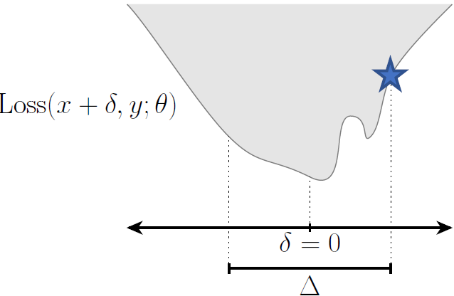
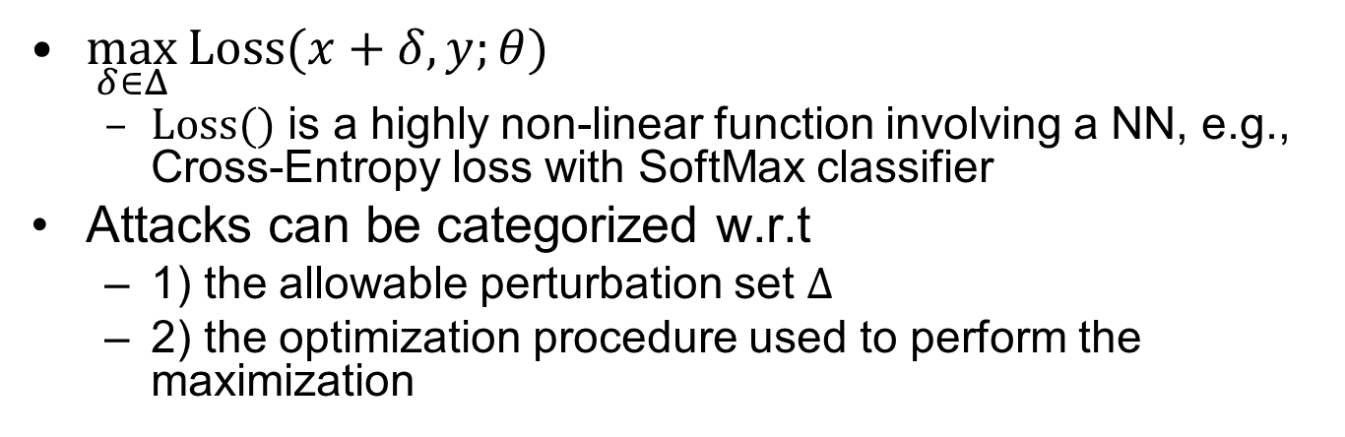
The Maximization Problem for Finding Adversarial Examples
$\max_{δ∈Δ}{Loss(x+δ,y;θ)}$
$Loss()$ is a highly non-linear function involving a NN, e.g., Cross-Entropy loss with SoftMax classifier
Attacks can be categorized w.r.t
1) the allowable perturbation set $Δ$
2) the optimization procedure used to perform the maximization

Slide 17
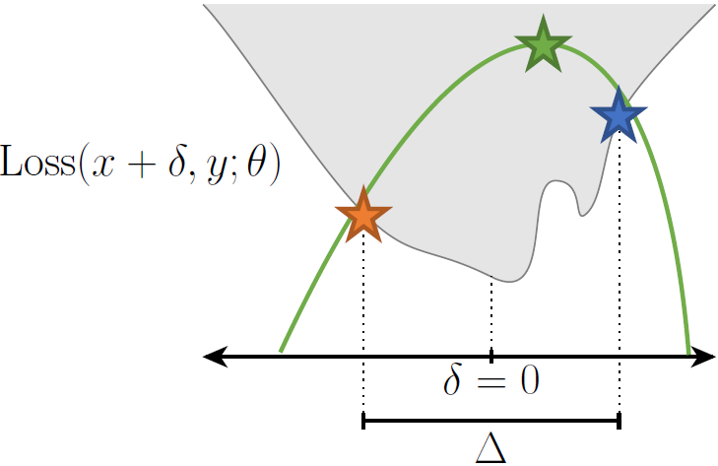
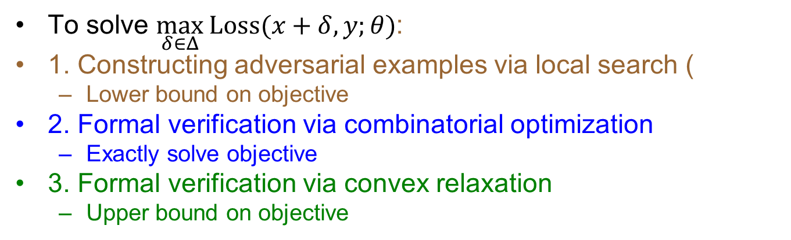
Three Approaches
To solve $\max_{δ∈Δ}{Loss(x+δ,y;θ)}$:
1. Constructing adversarial examples via local search (
Lower bound on objective
2. Formal verification via combinatorial optimization
Exactly solve objective
3. Formal verification via convex relaxation
Upper bound on objective
Notes:
We can find a lower bound on the optimization objective. Because (by definition) any feasible δ will give us a lower bound, this is equivalent to just “trying to empirically solve the optimization problem”, i.e., “find an adversarial example.”
We can attempt to solve the optimization problem exactly, e.g., by formulating it as a combinatorial optimization problem, and solve it exactly using techniques such as mixed Integer Linear Programming
We can also upper bound the optimization objective, similar to what we did with the multiclass linear case.

Slide 18
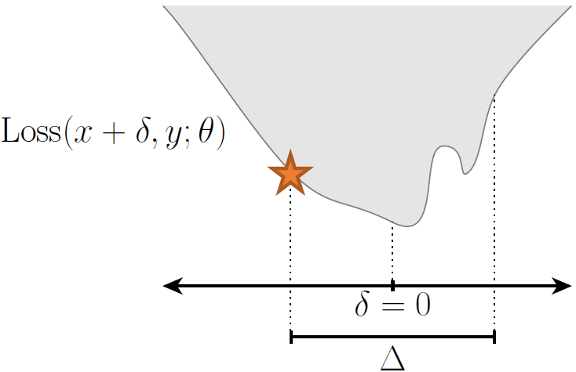
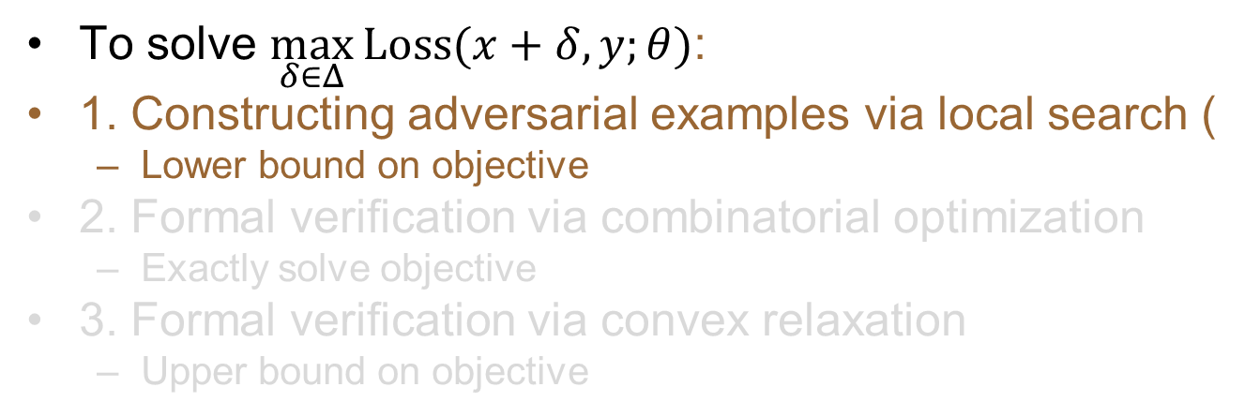
Approach #1
To solve $\max_{δ∈Δ}{Loss(x+δ,y;θ)}$:
1. Constructing adversarial examples via local search (
Lower bound on objective
2. Formal verification via combinatorial optimization
Exactly solve objective
3. Formal verification via convex relaxation
Upper bound on objective

Slide 19
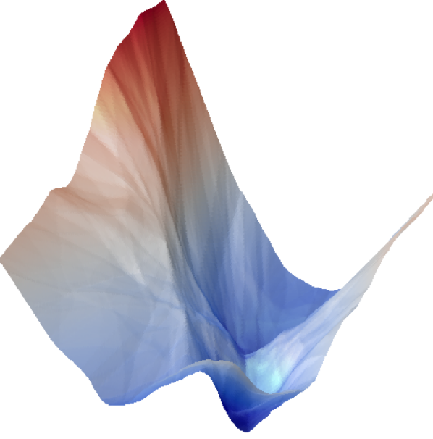
Local Search
The loss landscape of a NN is highly non-convex, inner maximization problem is difficult to solve exactly
We can find an approximate solution using gradient-based methods, similar to deep learning training

Slide 20

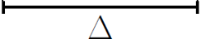
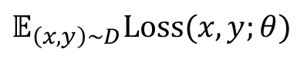
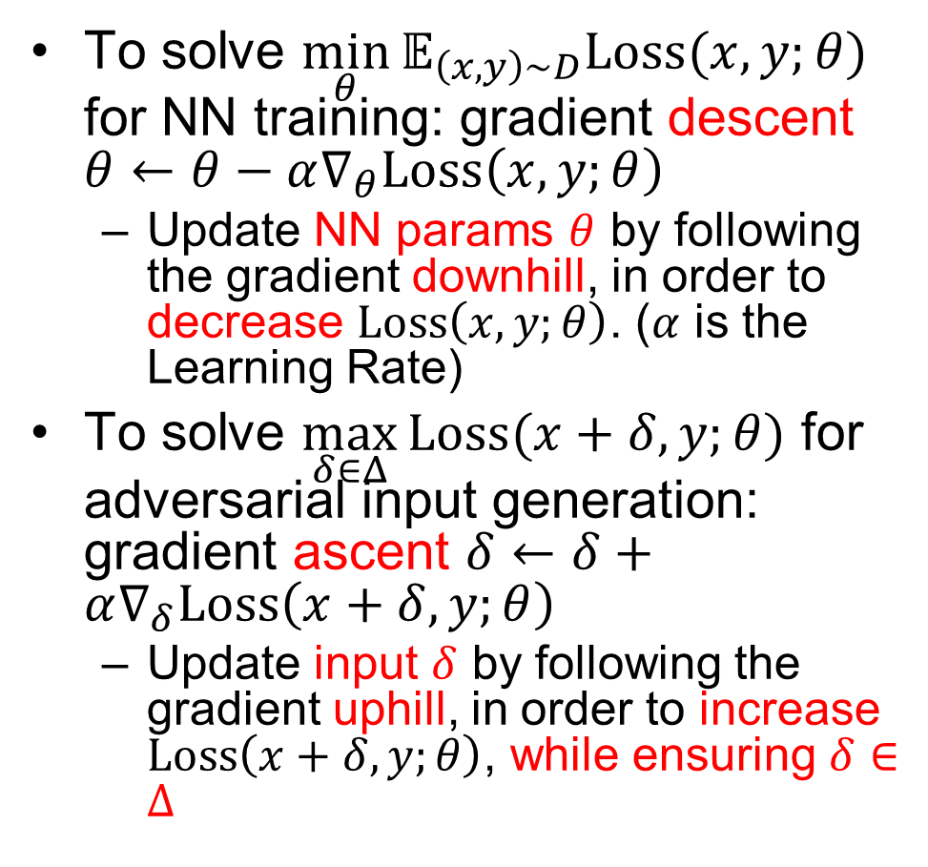

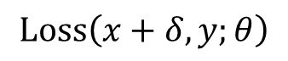

NN Training vs. Local Search for Adversarial Input Generation
To solve $\min_{θ}{𝔼_{\left(x,y\right)∼D}Loss(x,y;θ)}$ for NN training: gradient descent $θ←θ−α∇_{θ}Loss\left(x,y;θ\right)$
Update NN params $θ$ by following the gradient downhill, in order to decrease $Loss\left(x,y;θ\right)$. ($α$ is the Learning Rate)
To solve $\max_{δ∈Δ}{Loss(x+δ,y;θ)}$ for adversarial input generation: gradient ascent $δ←δ+α∇_{δ}Loss\left(x+δ,y;θ\right)$
Update input $δ$ by following the gradient uphill, in order to increase $Loss\left(x+δ,y;θ\right)$, while ensuring $δ∈Δ$
$$𝔼_{\left(x,y\right)∼D}Loss(x,y;θ)$$
$$θ$$
$$Loss\left(x+δ,y;θ\right)$$
$$δ$$

Slide 21
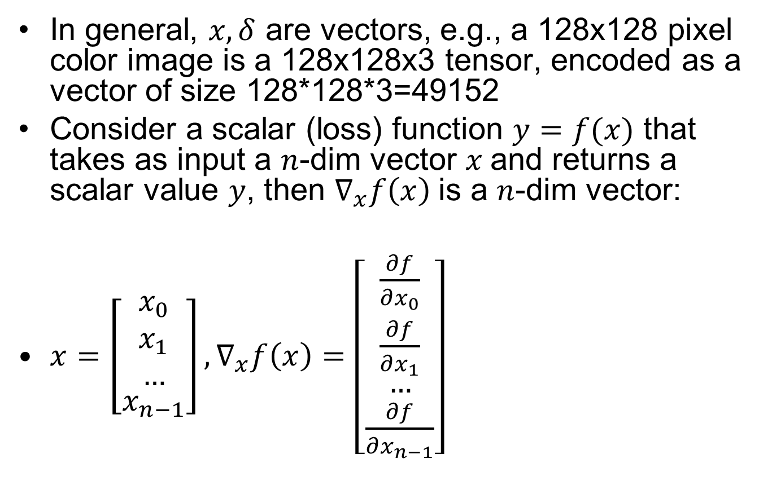
Aside: Vector Derivative
In general, $x,δ$ are vectors, e.g., a 128x128 pixel color image is a 128x128x3 tensor, encoded as a vector of size 128*128*3=49152
Consider a scalar (loss) function $y=f(x)$ that takes as input a $n$-dim vector $x$and returns a scalar value $y$, then $∇_{x}f\left(x\right)$ is a $n$-dim vector:
$x=\left[\begin{aligned}\begin{matrix}x_{0} \\ x_{1} \\ …\end{matrix} \\ x_{n−1}\end{aligned}\right],∇_{x}f\left(x\right)=\left[\begin{aligned}\begin{matrix}\frac{∂f}{∂x_{0}} \\ \frac{∂f}{∂x_{1}} \\ …\end{matrix} \\ \frac{∂f}{∂x_{n−1}}\end{aligned}\right]$

Slide 22
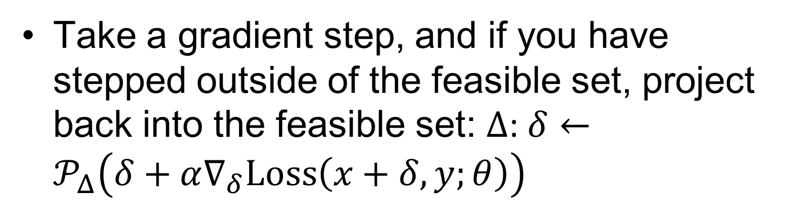
Projected Gradient Descent
Take a gradient step, and if you have stepped outside of the feasible set, project back into the feasible set: $Δ$: $δ←𝒫_{Δ}\left(δ+α∇_{δ}Loss\left(x+δ,y;θ\right)\right)$
Notes:
Lower left shows a gradient step followed by projection to the $l_{∞}$ ball: lower right shows projection to the $l_{2}$ ball

Slide 23

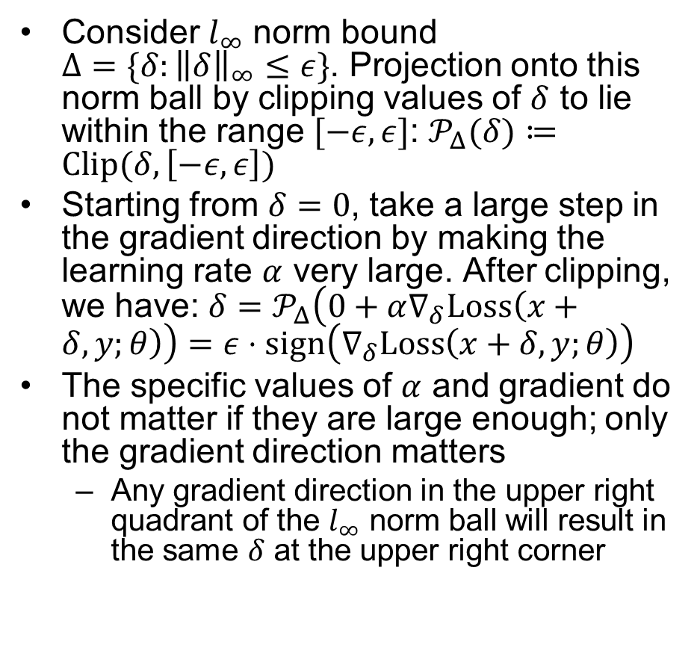
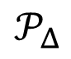
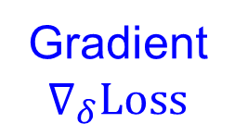
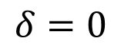
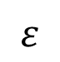
Fast Gradient Sign Method (FGSM)
Consider $l_{∞}$ norm bound ${Δ=\{δ:\left\|δ\right\|}_{∞}≤ε\}$. Projection onto this norm ball by clipping values of $δ$ to lie within the range $[−ε,ε]$: $𝒫_{Δ}(δ)≔Clip(δ, \left[−ε,ε\right])$
Starting from $δ=0$, take a large step in the gradient direction by making the learning rate $α$ very large. After clipping, we have: $δ=𝒫_{Δ}\left(0+α∇_{δ}Loss\left(x+δ,y;θ\right)\right)=ε⋅sign\left(∇_{δ}Loss\left(x+δ,y;θ\right)\right)$
The specific values of $α$ and gradient do not matter if they are large enough; only the gradient direction matters
Any gradient direction in the upper right quadrant of the $l_{∞}$ norm ball will result in the same $δ$ at the upper right corner
Gradient $∇_{δ}Loss$
$$𝒫_{Δ}$$
$$δ$$
$$ε$$
$$δ=0$$
Notes:
Untargeted attack:
Maximize $J\left(θ,x′,y\right)≈J\left(θ,x,y\right)+\left(x^{′}−x\right)⋅∇_{x}J\left(θ,x,y\right)$ (Taylor expansion)
s.t. ${\left\|x^{′}−x\right\|}_{∞}≤ε$
Solution: $x^{′}←x+ε\operatorname{sgn}{∇_{x}J\left(θ,x,y\right)}$
One step, no iteration

Slide 24
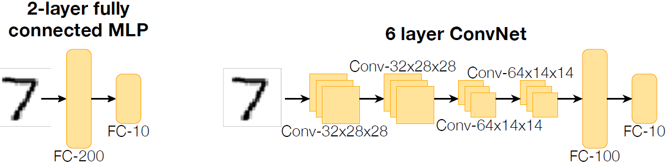
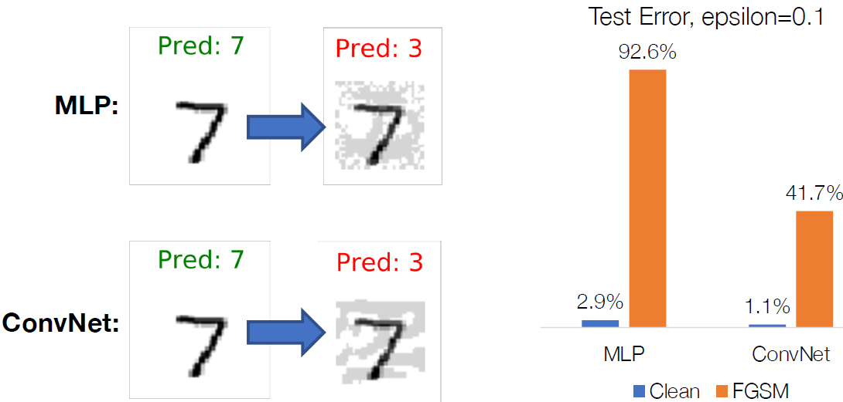
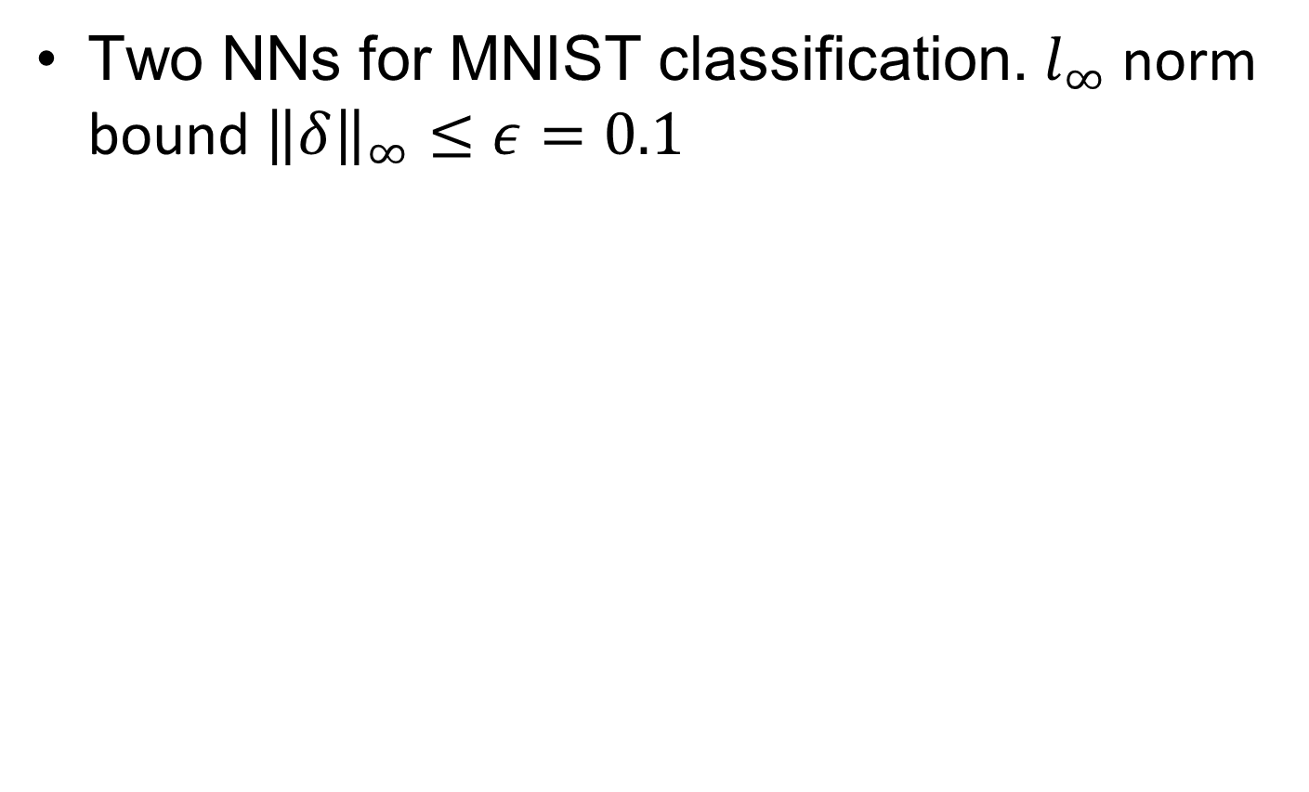
Adversarial Examples by FGSM
Two NNs for MNIST classification. $l_{∞}$ norm bound ${\left\|δ\right\|}_{∞}≤ε=0.1$
Notes:
2-layer fully connected Multi-Layer Perceptron
6-layer CNN

Slide 25
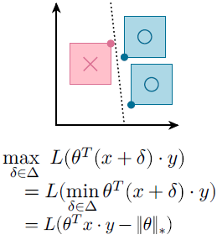
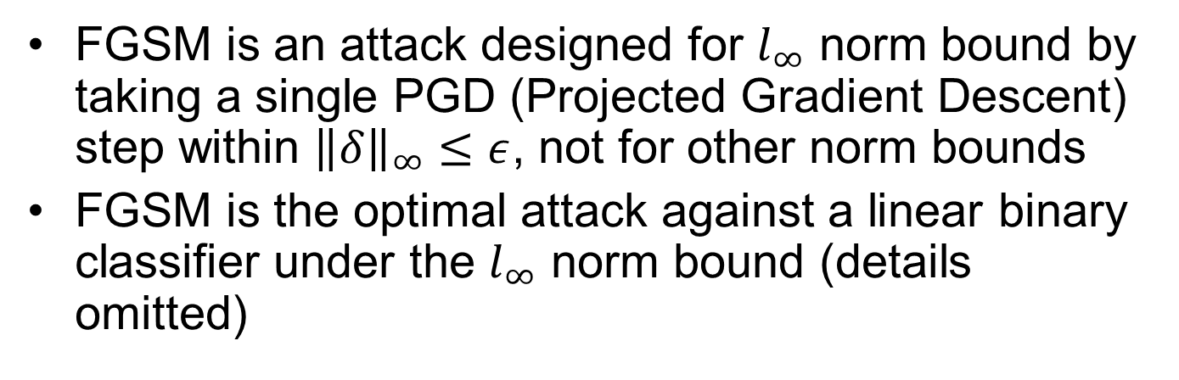
Comments on FGSM
FGSM is an attack designed for $l_{∞}$ norm bound by taking a single PGD (Projected Gradient Descent) step within ${\left\|δ\right\|}_{∞}≤ε$, not for other norm bounds
FGSM is the optimal attack against a linear binary classifier under the $l_{∞}$ norm bound (details omitted)

Slide 26
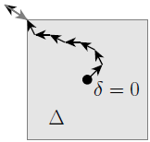
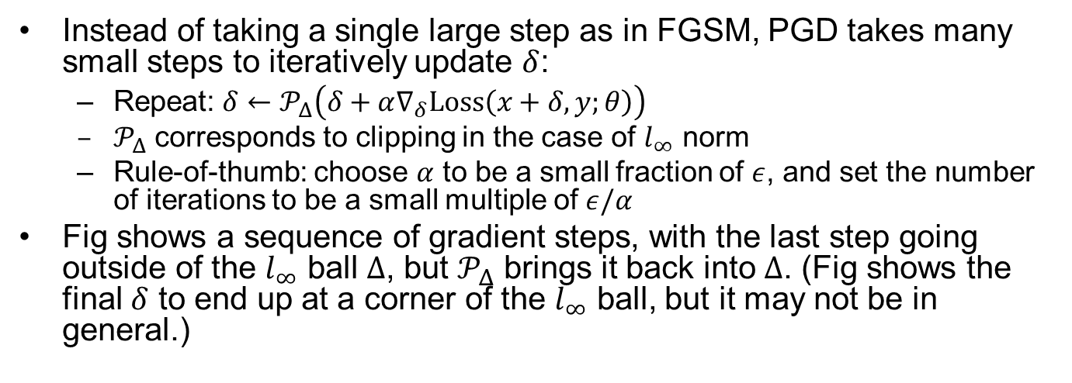
PGD w. Small Steps
Instead of taking a single large step as in FGSM, PGD takes many small steps to iteratively update $δ$:
Repeat: $δ←𝒫_{Δ}\left(δ+α∇_{δ}Loss\left(x+δ,y;θ\right)\right)$
$𝒫_{Δ}$ corresponds to clipping in the case of $l_{∞}$ norm
Rule-of-thumb: choose $α$ to be a small fraction of $ε$, and set the number of iterations to be a small multiple of $ε/α$
Fig shows a sequence of gradient steps, with the last step going outside of the $l_{∞}$ ball $Δ$, but $𝒫_{Δ}$ brings it back into $Δ$. (Fig shows the final $δ$ to end up at a corner of the $l_{∞}$ ball, but it may not be in general.)

Slide 27
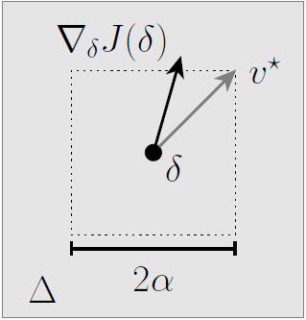
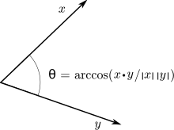

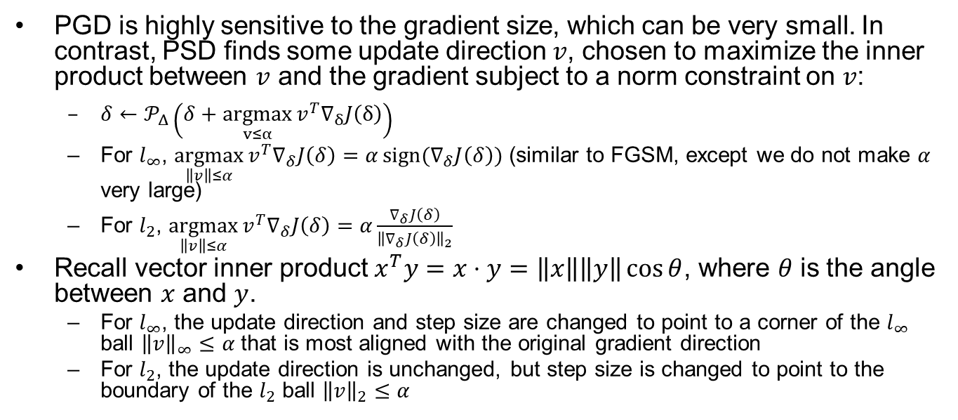


Projected Steepest Descent
PGD is highly sensitive to the gradient size, which can be very small. In contrast, PSD finds some update direction $v$, chosen to maximize the inner product between $v$ and the gradient subject to a norm constraint on $v$:
$δ←𝒫_{Δ}\left(δ+\underset{v≤α}{argmax}{v^{T}∇_{δ}J\left(δ\right)}\right)$
For $l_{∞}$, $\underset{\left\|v\right\|≤α}{argmax}{v^{T}∇_{δ}J\left(δ\right)}=α\operatorname{sign}{(∇_{δ}J\left(δ\right))}$ (similar to FGSM, except we do not make $α$ very large)
For $l_{2}$, $\underset{\left\|v\right\|≤α}{argmax}{v^{T}∇_{δ}J\left(δ\right)}=α\frac{∇_{δ}J\left(δ\right)}{{\left\|∇_{δ}J\left(δ\right)\right\|}_{2}}$
Recall vector inner product $x^{T}y=x⋅y=\left\|x\right\|\left\|y\right\|\cos{θ}$, where $θ$ is the angle between $x$ and $y$.
For $l_{∞}$, the update direction and step size are changed to point to a corner of the $l_{∞}$ ball ${\left\|v\right\|}_{∞}≤α$ that is most aligned with the original gradient direction
For $l_{2}$, the update direction is unchanged, but step size is changed to point to the boundary of the $l_{2}$ ball ${\left\|v\right\|}_{2}≤α$
$$v^{∗}$$
$$∇_{δ}J\left(δ\right)$$
$$2α$$
Notes:
Delta+scalarFor both cases, step size is normalized to $α$
Repeat $δ≔𝒫_{ε}(δ+α\frac{∇_{δ}l\left(h_{θ}\left(x+δ\right),y\right)}{{\left\|∇_{δ}l\left(h_{θ}\left(x+δ\right),y\right)\right\|}_{2}})$
where $𝒫$ denotes projection onto the $l_{2}$ ball of radius $ε$: $𝒫_{ε}(z)=ε\frac{z}{max\left\{ε,{\left\|z\right\|}_{2}\right\}}{ }$

Slide 28

Illustration of PGD

Slide 29

Recall: Cross-Entropy Loss for Multi-Class Classification
The SoftMax operator $σ:ℝ^{k}→ℝ^{k}$computes a vector of predicted probabilities $σ(z):ℝ^{k}$ from a vector of logits $z:ℝ^{k}$, where $k$ is the number of classes:
$σ{\left(z\right)}_{i}=\frac{\exp\left(z_{i}\right)}{\sum_{j=1}^{k}{\exp\left(z_{j}\right)}}$
The loss function is defined as the negative log likelihood of the predicted probability corresponding to the correct label $y$:
$Loss\left(h_{θ}\left(x\right),y\right)=−\log{σ{\left(h_{θ}\left(x\right)\right)}_{y}=}−\log\left(\frac{\exp\left(h_{θ}{\left(x\right)}_{y}\right)}{\sum_{j=1}^{k}{\exp\left(h_{θ}{\left(x\right)}_{j}\right)}}\right)=\log\left(\sum_{j=1}^{k}{\exp\left(h_{θ}{\left(x\right)}_{j}\right)}\right)−h_{θ}{\left(x\right)}_{y}$
Minimizing $Loss\left(h_{θ}\left(x\right),y\right)$ amounts to maximizing the logit ${\left(h_{θ}\left(x\right)\right)}_{y}$ corresponding to the correct label $y$
Notes:
$$Loss\left(x+δ,y;θ\right)=\log{\sum_{i}{\exp{h_{θ}{\left(x+δ\right)}_{i}−h_{θ}{\left(x\right)}_{y}}}}$$
Pred now contains a 1000 dimensional vector containing the class logits for the 1000 imagenet classes (i.e., if you wanted to convert this to a probability vector, you would apply the softmax operator to this vector). To find the highest likelihood class, we simply take the index of maximum value in this vector, and we can look this up in a list of imagenet classes to find the corresponding label.

Slide 30

Targeted Attacks
Explicitly try to change label to a particular target class $y_{targ}$:
$\max_{δ∈Δ}{(Loss\left(x+δ,y;θ\right)−Loss\left(x+δ,y_{targ};θ\right)}$
Recall Cross-Entropy loss from “L3 Intro to ML”:
$Loss\left(x+δ,y;θ\right)=\log\left(\sum_{j=1}^{k}{\exp\left(h_{θ}{\left(x+δ\right)}_{j}\right)}\right)−h_{θ}{\left(x+δ\right)}_{y}$
The maximization problem aims to maximize logit ${\left(h_{θ}\left(x\right)\right)}_{y_{targ}}$ of the target class $y_{targ}$, and minimize logit ${\left(h_{θ}\left(x\right)\right)}_{y}$ of the true class $y$:
$\max_{δ∈Δ}{(h_{θ}{\left(x+δ\right)}_{y_{targ}}−h_{θ}{\left(x+δ\right)}_{y})}$
An alternative is to maximize the logit ${\left(h_{θ}\left(x\right)\right)}_{y_{targ}}$ of the target class $y_{targ}$, and minimize the logit ${\left(h_{θ}\left(x\right)\right)}_{y′}$ of all the other classes $y′$:
$\max_{δ∈Δ}{(h_{θ}{\left(x+δ\right)}_{y_{targ}}−\sum_{y^{′}≠y_{targ}}{h_{θ}{\left(x+δ\right)}_{y^{′}}})}$
(We are optimizing the logits at the last linear layer before applying the SoftMax operator. Since SoftMax is a monotonically-increasing function, removing it does not affect the solution of $δ$)
Notes:
$$\max_{\left\|δ\right\|≤ε}{(h_{θ}{\left(x+δ\right)}_{y_{targ}}−h_{θ}{\left(x+δ\right)}_{y})}$$
Or, maximize the target class logit and minimize all the other logits: For a given input image $x$, find a small perturbation $δ$ s.t.
$f_{θ}\left(x+δ\right)≠y$ (untargeted attack)
$f_{θ}\left(x+δ\right)=t≠y$ (targeted attack)
to minimize the logit ${\left(h_{θ}\left(x\right)\right)}_{y′}$ of all correct class $y$, and maximize the logit ${\left(h_{θ}\left(x\right)\right)}_{y_{targ}}$ of all the the target class $y_{targ}$:
maximize the logit of target class $y_{targ}$and minimize logits of all the other labels $y′$
$$\max_{\left\|δ\right\|≤ε}{(h_{θ}{\left(x+δ\right)}_{y_{targ}}−\sum_{y^{′}≠y_targ}{h_{θ}{\left(x+δ\right)}_{y′}})}$$

Slide 31

Targeted Attacks Examples
Note: It is possible for a targeted attack to succeed in fooling the classifier, but change to a different label than the target

Slide 32

Physically-Realizable Attacks
Instead of directly manipulating pixels, it is possible to modify physical objects and cause miss-classification
[Evtimov et al 2017]: Physical Adversarial Examples Against Deep Neural Networks
https://bair.berkeley.edu/blog/2017/12/30/yolo-attack/

Slide 33


An optimization approach to creating robust adversarial examples
The following optimization problem for targeted attack aims to minimize the cost function for input $x+δ$ and target label $y_{targ}$ ($λ$ is the Lagrange multiplier; the objective tries to minimize the perturbation ${\left\|δ\right\|}_{p}$ instead of putting a hard bound on ${\left\|δ\right\|}_{p}$)
${argmin}_{δ}{λ{\left\|δ\right\|}_{p}+J(f_{θ}\left(x+δ\right),y_{targ})}$
To create a universal perturbation for robust adversarial examples, enhance the training dataset with multiple ($k$) variants of the input image at different viewing angles and lighting conditions
${argmin}_{δ}{λ{\left\|δ\right\|}_{p}+\frac{1}{k}\sum_{i=1}^{k}{J(f_{θ}\left(x+δ\right),y^{∗})}}$
Notes:
https://en.wikipedia.org/wiki/Lagrange_multiplier

Slide 34


Optimizing Spatial Constraints
To make the perturbation imperceptible to humans, we add a mask $M_{x}$ to localize the perturbation to specific areas of the Stop Sign to mimic vandalism:
${argmin}_{δ}{λ{\left\|M_{x}⋅δ\right\|}_{p}+\frac{1}{k}\sum_{i=1}^{k}{J(f_{θ}\left(x+M_{x}⋅δ\right),y^{∗})}}$
Use $l_{1}$ norm in ${\left\|M_{x}⋅δ\right\|}_{1}$ to find the most vulnerable regions (since $l_{1}$ loss promotes sparsity), then generate perturbation $δ$ within these regions
Video demos:
“Bo Li – Secure Learning in Adversarial Autonomous Driving Environments” https://www.youtube.com/watch?v=0VfBGWnFNuw&t=421s
Notes:
https://www.youtube.com/watch?v=0VfBGWnFNuw&t=421s Bo Li – Secure Learning in Adversarial Autonomous Driving Environments

Slide 35

Adversarial Traffic Signs

Slide 36

Attacks on Face Recognition
1. An attacker would need to find perturbations that generalize beyond a single image.
2. Small differences between adjacent pixels in the perturbation are unlikely to be accurately captured by cameras, so make the perturbation form large patches.
3. It is desirable to craft perturbations that are comprised mostly of colors reproducible by the printer.
https://www.cs.cmu.edu/~sbhagava/papers/face-rec-ccs16.pdf

Slide 37


Blackbox Attacks
We have been discussing Whitebox attacks, where we know the NN model parameters 𝜃
Black Box Attacks:
If you have the training dataset of the target Blackbox model:
Train a proxy Whitebox model yourself
Generate attacked objects for the proxy model
If you do not have the training dataset, you can obtain input-output data pairs from the target Blackbox model by invoking online cloud services
May get expensive if the cloud service is not free
Attacked
Input Image
Target
Blackbox Model
Proxy
Whitebox
Model
Training Data

Slide 38

Blackbox Attack Example
[Evtimov et al 2017]: Physical adversarial examples generated for the YOLO object detector (the proxy Whitebox model) are also be able to fool Faster-RCNN (the Blackbox model)

Slide 39

DeepBillboard
Goal: generate a single adversarial billboard image that may mislead the steering angle of an AV upon every single frame captured by onboard camera during the process of driving by a billboard.
Zhou H, Li W, Kong Z, et al. Deepbillboard: Systematic physical-world testing of autonomous driving systems[C]//2020 IEEE/ACM 42nd International Conference on Software Engineering (ICSE). IEEE, 2020: 347-358.
Notes:
Goal: generate a single printable image physically pasted on a roadside billboard to fool the AD camera

Slide 40


DeepBillboard Workflow
To generate adversarial perturbations for contiguous frames,
1. Training dataset generation: pre-fill the billboard with unicolor, and paint its four corners with contrasting colors. Record video while driving by the billboard with different speeds and angles
2. Training algorithm: 1. Generate locally-best perturbation for each single frame; 2. Find a single perturbation that misleads DNNs best for multiple consecutive frames ($p_{i}$ represents the i-th frame), using a joint loss optimization method; 3. Transfer RGB values to printable colors

Slide 41



Phantom of the ADAS
A phantom is a depthless presented/projected picture of a 3D object (e.g., pedestrian, traffic sign, car, truck, bicycle…), with the purpose of fooling ADAS to treat it as a real object and trigger an automatic reaction
Phantom attacks by projecting a phantom via a drone equipped with a portable projector:
https://www.youtube.com/watch?v=1cSw4fXYqWI&t=85s
or by presenting a phantom on a hacked roadside digital billboard:
https://www.youtube.com/watch?v=-E0t_s6bT_4
https://www.nassiben.com/phantoms
Notes:
“we investigate a new perceptual challenge that causes the ADASs and autopilots of semi/fully autonomous to consider depthless objects (phantoms) as real. We show how attackers can exploit this perceptual challenge to apply phantom attacks and change the abovementioned balance, without the need to physically approach the attack scene, by projecting a phantom via a drone equipped with a portable projector or by presenting a phantom on a hacked digital billboard that faces the Internet and is located near roads. We show that the car industry has not considered this type of attack by demonstrating the attack on today’s most advanced ADAS and autopilot technologies: Mobileye 630 PRO and the Tesla Model X, HW 2.5; our experiments show that when presented with various phantoms, a car’s ADAS or autopilot considers the phantoms as real objects, causing these systems to trigger the brakes, steer into the lane of oncoming traffic, and issue notifications about fake road signs. In order to mitigate this attack, we present a model that analyzes a detected object’s context, surface, and reflected light, which is capable of detecting phantoms with 0.99 AUC. ”

Slide 42



Algorithm for Disguising Phantoms
1. Extract key points as focus areas of human attention for every frame based on the SURF algorithm
2. Compute a local score for every block in a frame that represents how distant a block is from the focus areas, and embed phantoms into “dead areas” that viewers will not focus on
3. Display the phantom in at least $t$ consecutive video frames (longer duration leads to higher success rate)

Slide 43

Countermeasure - GhostBusters
When a frame is captured, (1) the on-board object detector locates a road sign, (2) the road sign is cropped and passed to the Context, Surface, Light, and Depth models, and (3) the Combiner model interprets the models’ embeddings and makes a final decision on the traffic sign (real or fake).

Slide 44

Constraints on Perturbations?
In both DeepBillboard and Phantom of the ADAS attacks, there is no $δ∈Δ$ norm constraint on the allowable perturbations
DeepBillboard simply assumes human drivers don’t pay attention to roadside billboards, so the entire area of the billboard can be used for attack
Phantom of the ADAS embeds phantoms into “dead areas” that human viewers will not focus on
The $δ∈Δ$ norm constraint may not be fully aligned with human perception

Slide 45

Approach #2
To solve $\max_{δ∈Δ}{Loss(x+δ,y;θ)}$:
1. Constructing adversarial examples via local search (
Lower bound on objective
2. Formal verification via combinatorial optimization
Exactly solve objective
3. Formal verification via convex relaxation
Upper bound on objective

Slide 46

Exact Combinatorial Optimization
Consider a ReLU-based $d\text{−}\text{layer}$ feedforward NN $h_{θ\left(x\right)}$, defined by:
$z_{1}=x$
$z_{i+1}=ReLU\left(W_{i}z_{i}+b_{i}\right),i=1,…,d−1$
$h_{θ}\left(x\right)=z_{d+1}=W_{d}z_{d}+b_{d}$, where params $θ=\{W_{1},b_{1},…,W_{d},b_{d}\}$
Targeted attack in $l_{∞}$ norm:
$\min_{z_{1:d+1}}{{\left(e_{y}−e_{y_{targ}}\right)}^{T}z_{d+1}}$ s.t.
$z_{i+1}=ReLU\left(W_{i}z_{i}+b_{i}\right),i=1,…,d−1$
$z_{d+1}=W_{d}z_{d}+b_{d}$
${\left\|z_{1}−x\right\|}_{∞}≤ε$
where $e_{i}$ denotes the unit basis, i.e., a vector with a $1$ in the i-th position and $0$s everywhere else; and where we removed the explicit $δ$ term in favor of a constraint that simply requires $z_{1}$ (the input to the first layer), to be within $ε$ of $x$.
Example: binary classification $y=cat, y_{target}=dog$. $e_{y}=\left[\begin{matrix}1 \\ 0\end{matrix}\right],e_{y_{targ}}=\left[\begin{matrix}0 \\ 1\end{matrix}\right]$. The objective function is $\left[\begin{matrix}1 & −1\end{matrix}\right]\left[\begin{matrix}{\left(z_{d+1}\right)}_{y} \\ {\left(z_{d+1}\right)}_{y_{targ} }\end{matrix}\right]={\left(z_{d+1}\right)}_{y}−{\left(z_{d+1}\right)}_{y_{targ} }$
Minimizing this objective function: try to increase the logit ${\left(z_{d+1}\right)}_{y_{targ} }$and decrease the logit ${\left(z_{d+1}\right)}_{y}$
Notes:
Zd+1 is fully determined by zd, so why it is an optimization var? Note that there is no SoftMax operator applied to the logits at the last linear layer $z_{d+1}$. Since SoftMax is a monotonically increasing function, removing it does not affect optimization result

Slide 47

Solving the Combinatorial Problem
The optimization formulation of an adversarial attack can be written as an binary mixed Integer Linear Program (ILP) or a Satisfiability Modulo Theories (SMT) problem
In practice, off-the-shelf solvers (CPLEX, Gurobi, etc) can scale to ~100 hidden units, but size depends heavily on problem structure (including, e.g, the size of $ε$)
One of the key aspects of finding an efficient solution is to provide tight bounds on the pre-ReLU activations $W_{i}z_{i}+b_{i}∈[l_{i},u_{i}]$

Slide 48








Encoding ReLU w. ILP
ReLU: $z_{i+1}=\max\left\{0,W_{i}z_{i}+b_{i}\right\}, l_{i}≤W_{i}z_{i}+b_{i}≤u_{i}$
Linearization: we introduce a vector of binary variables $v_{i}$ with same size as $z_{i+1}$. A vector inequality constraint is applied elementwise to the vector
Proof that the set of constraints on the left encodes the ReLU:
$$W_{i}z_{i}+b_{i}≥0⇒v_{i}=1$$
$$z_{i+1}≥W_{i}z_{i}+b_{i}$$
$$z_{i+1}≥0$$
$$u_{i}≥z_{i+1}$$
$$W_{i}z_{i}+b_{i}≥z_{i+1}$$
$$z_{i+1}=W_{i}z_{i}+b_{i}$$
$$z_{i+1}≥W_{i}z_{i}+b_{i}$$
$$z_{i+1}≥0$$
$$u_{i}⋅v_{i}≥z_{i+1}$$
$$W_{i}z_{i}+b_{i}≥z_{i+1}+\left(1−v_{i}\right)⋅l_{i}$$
$$v_{i}∈{\left\{0,1\right\}}^{\left|v_{i}\right|}$$
$$z_{i+1}≥W_{i}z_{i}+b_{i}$$
$$z_{i+1}≥0$$
$$0≥z_{i+1}$$
$$W_{i}z_{i}+b_{i}≥z_{i+1}+l_{i}$$
$$z_{i+1}=0$$
$$W_{i}z_{i}+b_{i}<0⇒v_{i}=0$$

Slide 49


Bound Propagation
How to get the bounds at each layer $l_{i}≤W_{i}z_{i}+b_{i}≤u_{i}$?
If $l≤z≤u$, then ${\left[W\right]}_{+}l+{\left[W\right]}_{−}u+b≤Wz+b≤{\left[W\right]}_{+}u+{\left[W\right]}_{−}l+b$
where ${\left[W\right]}_{−}≔\min\left\{W,0\right\},{\left[W\right]}_{+}≔\max{\{W,0\}}$.
It is a loose bound in general, but still useful
Tighter bounds lead to higher computational efficiency of the MILP solver; tightness of the bounds does not affect optimality of the result, as long as the bounds are safe
Notes:
Let’s consider a single entry ${\left(Wz+b\right)}_{i}=\sum_{j}{w_{ij}z_{j}+b_{i}}$

Slide 50


Bound Propagation Example
$W=\left[\begin{matrix}1 & 1 \\ 1 & −1\end{matrix}\right],\left[\begin{matrix}0 \\ .1\end{matrix}\right]≤z=\left[\begin{matrix}x_{1} \\ x_{2}\end{matrix}\right]≤\left[\begin{matrix}.3 \\ .4\end{matrix}\right],b=0$
$\left[\begin{matrix}.1 \\ −.4\end{matrix}\right]=\left[\begin{matrix}1 & 1 \\ 1 & 0\end{matrix}\right]\left[\begin{matrix}0 \\ .1\end{matrix}\right]+\left[\begin{matrix}0 & 0 \\ 0 & −1\end{matrix}\right]\left[\begin{matrix}.3 \\ .4\end{matrix}\right]≤Wz=\left[\begin{matrix}x_{3} \\ x_{4}\end{matrix}\right]≤\left[\begin{matrix}1 & 1 \\ 1 & 0\end{matrix}\right]\left[\begin{matrix}.3 \\ .4\end{matrix}\right]+\left[\begin{matrix}0 & 0 \\ 0 & −1\end{matrix}\right]\left[\begin{matrix}0 \\ .1\end{matrix}\right]=\left[\begin{matrix}.7 \\ .2\end{matrix}\right]$
To get $Wz$’s lower bound, whenever a scalar element of matrix $W$ is negative (positive), set the corresponding entry in vector $z$ to be its upper (lower) bound
To get $Wz$’s upper bound, whenever a scalar element of matrix $W$ is negative (positive), set the corresponding entry in vector $z$ to be its lower (upper) bound

Slide 51

Final ILP Formulation
$\min_{z_{1:d+1},v_{1:d−1}}{{\left(e_{y}−e_{y_{targ}}\right)}^{T}z_{d+1}}$ s.t.
(Éncoding ReLU $z_{i+1}=ReLU\left(W_{i}z_{i}+b_{i}\right),i=1,…,d−1$)
$z_{i+1}≥W_{i}z_{i}+b_{i}, i=1,…,d−1$
$z_{i+1}≥0, i=1,…,d−1$
$u_{i}⋅v_{i}≥z_{i+1},i=1,…,d−1$
$W_{i}z_{i}+b_{i}≥z_{i+1}+\left(1−v_{i}\right)l_{i},i=1,…,d−1$
$v_{i}∈{\left\{0,1\right\}}^{\left|v_{i}\right|},i=1,…,d−1$
(Encoding ${\left\|z_{1}−x\right\|}_{∞}≤ε$)
$z_{1}≤x+ε$
$z_{1}≥x−ε$
(Last linear layer)
$z_{d+1}=W_{d}z_{d}+b_{d}$
Can be solved with solvers like CPEX or cvxpy+Gurobi

Slide 52


Certifying Robustness
Consider the optimization objective ${\left(e_{y}−e_{y_{targ}}\right)}^{T}z_{d+1}$. If we solve it for some $y_{targ}$ and the objective is positive, then this gives a robustness certificate: Given a data input $x$ and a NN model, under the specified threat model (e.g., $l_{∞}$-norm ball ${\left\|z_{1}−x\right\|}_{∞}≤ε$), the top-1 prediction of the perturbed input will not be altered to $y_{targ}$, i.e., there exists no adversarial example for target class $y_{targ}$
Example: binary classification $y=cat, y_{target}=dog$. If $\min_{z_{1:d}}\left({\left(z_{d+1}\right)}_{y}−{\left(z_{d+1}\right)}_{y_{targ}}\right)>0$, then it is not possible to misclassify a perturbed cat image as a dog
If the objective is positive for all $y_{targ}$, this is a verified proof that there exists no adversarial example at all

Slide 53

Certified Robustness Illustration
ECCV 2020 Tutorial on Adversarial Robustness of Deep Learning Models by Pin-Yu Chen (IBM Research)

Slide 54


Certified Robustness Illustration
We can use an iterative process (e.g. binary search) to find the maximum $ε$ for the robustness certificate
ECCV 2020 Tutorial on Adversarial Robustness of Deep Learning Models by Pin-Yu Chen (IBM Research)

Slide 55


Approach #3
To solve $\max_{δ∈Δ}{Loss(x+δ,y;θ)}$:
1. Constructing adversarial examples via local search (
Lower bound on objective
2. Formal verification via combinatorial optimization
Exactly solve objective
3. Formal verification via convex relaxation
Upper bound on objective

Slide 56



Convex Relaxation
For a ReLU-based NN, solving the ILP with $v_{i}∈{\left\{0,1\right\}}^{\left|v_{i}\right|}$ (the ReLU can be either off or on) is too computationally expensive
Convex relaxation: replace the ReLU constraints with their convex hull $0≤v_{i}≤1$ (the ReLU can be partially off and partially on). Then optimization problem becomes a Linear Program (instead of ILP)
Accurate ReLU
Convex relaxation
of ReLU

Slide 57


Convex Relaxation as Conservative Approximation
Convex relaxation provides a strict lower bound on the ILP objective (because feasible set is larger) $Obj(LP) ≤ Obj(ILP)$ (refer to p. 17)
If $Objective(LP)$ is still positive for all target classes, the relaxation gives a verifiable proof that no adversarial example exists
If $Objective(LP)$ may be negative for some target class, we can say nothing about existence of adversarial examples. Solving the relaxed problem does not actually produce a true adversarial example anymore. The relaxation may be able to construct an example with a negative objective, even though no actual example could achieve this

Slide 58

Interval-based Bounds
We can formulate optimization considering only bound constraints. We propagate interval bounds to the second-to-last layer $z_{d}$, and then solve the minimization problem at the last linear layer:
$\min_{z_{d} }{c^{T}\left(W_{d}z_{d}+b_{d}\right)=(c^{T}W_{d})z_{d}+c^{T}b_{d}}$ s.t.
$l≤z_{d}≤u$
Since the minimization problem is to find the lower bound, the solution is to choose ${\left(z_{d}\right)}_{j}=l_{j}$ if ${\left(c^{T}W_{d}\right)}_{j}>0$, and ${\left(z_{d}\right)}_{j}=u_{j}$ otherwise. This results in the analytical solution for the optimal objective:
$\min_{z_{d} }{c^{T}\left(W_{d}z_{d}+b_{d}\right)}={\left[c^{T}W_{d}\right]}_{+}l+{\left[c^{T}W_{d}\right]}_{−}u+c^{T}b_{d}$
These bounds are even more pessimistic than bounds obtained by convex relaxation. There is no single input (even with relaxed activations) that creates these bounds on the logit differences: each individual activation assumes that the previous layer could take on a separate set of values to minimize or maximize just that one activation
Notes:
$\min_{z_{d}, z_{d+1}}{c^{T}z_{d+1}}$ s.t. (note the optimization variables only include $z_{d}$, instead of $z_{1:d+1}$)
$$z_{d+1}=W_{d}z_{d}+b_{d}$$
$$l≤z_{d}≤u$$

Slide 59
Outline
Introduction
Adversarial examples and verification
Constructing adversarial examples via local search
Physically-realizable attacks
Formal verification via combinatorial optimization
Formal verification via convex relaxations
Training adversarially robust models
Adversarial robustness beyond security

Slide 60



Adversarial Training w. Outer Minimization
(omitted)
Higher network capacity enables more complex decision boundary and more robust classification

Slide 61

Danskin’s Theorem
How to compute the gradient of the objective with the $max⁡$ term inside?
Danskin’s Theorem: $∇_{θ}\max_{δ∈Δ}{Loss(x+δ,y;θ)}=∇_{θ}Loss(x+δ^{∗},y;θ)$
where $δ^{∗}=\max_{δ∈Δ}{Loss(x+δ,y;θ)}$
It means we can optimize through the $max⁡$ operator by finding the $δ^{∗}$ that maximizes the loss function, then taking gradient at the point $x+δ^{∗}$
It only applies when $max$ is performed exactly
Notes:
We would like to solve it with gradient descent, but $\min_{θ}{\sum_{x,y∈S}{\max_{δ∈Δ}{L(x+δ,y;θ)}}}$

Slide 62

Adversarial Training [Goodfellow et al., 2014]
In theory, Danskin’s theorem only applies to the case where we are able to compute the maximum exactly. In practice, the quality of the robust gradient descent procedure is tied directly to how well we are able to perform the inner maximization. In other words, the key aspect is incorporate a strong attack into the inner maximization procedure.
Notes:
Common to also mix robust/standard
updates (not done in our case)

Slide 63

Evaluating Robust Models
Our model looks good, but we also need to evaluate against different attacks, PGD attacks run for longer, with random restarts, etc
Note: it is not very informative to evaluate against a different type of attack, e.g. evaluate $l_{∞}$ robust model against $l_{1}$ or $l_{2}$ attacks

Slide 64


What Makes the Models Robust?
The robust model has a smoother loss surface, making it more difficult for an attacker to change the class label with small gradient steps

Slide 65









Loss Surfaces Examples
Upper right fig shows a smooth loss surface with small gradients near the correct label and large distances to other labels, which makes attacks more difficult
Lower right fig shows a less smooth loss surface and small distances to other labels, which makes attacks easier
You can also think of them as 2 different directions on the same loss surface, and the attacker’s goal is to find the optimal direction to change input $x$ (e.g., by gradient ascent with FGSM or PGD)
$$y′$$
$$y$$
$$y′′$$
$$x$$
$$y′$$
$$y$$
$$y′′$$
$$x$$
Notes:
Specific DirectionRandom

Slide 66





Smoothing Filter on the Input as Defense
Original Image
Smoothed Image
The filter helps make the loss surface smoother, which makes attacks more difficult
Not a very effective defense. Furthermore, if attacker knows the filter, the defense is no longer effective
Filter
$$+$$
$$+$$
e.g. Smoothing
Attack signal $δ$
Smoothed attack signal $δ$ is less effective
Image credit: Hung-yi Lee

Slide 67
Outline
Introduction
Adversarial examples and verification
Constructing adversarial examples via local search
Physically-realizable attacks
Formal verification via combinatorial optimization
Formal verification via convex relaxations
Training adversarially robust models
Adversarial robustness beyond security

Slide 68



Adv. Robust Generalization Needs More Data to Avoid Overfitting
Theorem [Schmidt Santurkar Tsipras Talwar M 2018]: Sample complexity of adv. robust generalization can be significantly larger than that of “standard” generalization
Specifically: There exists a $d$-dimensional distribution $D$ s.t.:
A single sample is enough to get an accurate classifier (P[correct] > 0.99)
But need $Ω(\sqrt{d})$ samples for better-than-chance robust classifier

Slide 69

Does Being Robust Help “Standard” Generalization?
Data augmentation: An effective technique to improve “standard” generalization
Adversarial training = An “ultimate” version of data augmentation
(since we train on the ”most confusing” version of the training set)
Does adversarial training always improve “standard” generalization?
No. Adversarial training typically results in lower performance when evaluated on standard input

Slide 70

Does Being Robust Help “Standard” Generalization?
Theorem [Tsipras et al. 2018]: No “free lunch”: trade-off between accuracy and robustness
Standard training tries to use all features to maximize model accuracy, incl. non-robust features (e.g., outdoor scenery for class label “dog”), and the resulting model is vulnerable to adversarial examples that manipulate the non-robust features w. minor perturbations
Adversarial training tries to use only robust features (e.g., human-recognizable dog features like ears, tail, black nose…for class label “dog”) to increase model robustness at the cost of reduced accuracy, since larger and more noticeable perturbations are needed to change the robust features

Slide 71
Adversarial Robustness is Not Free
Optimization during training more difficult and models need to be larger
More training data might be required
Might need to lose on “standard” measures of performance like precision, recall, accuracy

Slide 72

But There Are (Unexpected?) Benefits Too
Models become more semantically meaningful
Fig shows heatmaps highlighting the pixels that maximally activate the output neuron with the predicted label

Slide 73


But There Are (Unexpected?) Benefits Too
Lower left: an input image, correctly labeled as “Primate”
Lower middle: an adversarial input that fools a standard model into misclassification as “Bird”
Minor perturbation undetectable by humans
Lower right: an adversarial input that fools an adv. robust model into misclassification as “Bird”
Semantically-meaningful perturbation detectable by humans
Attack

Slide 74
Conclusions
Algorithms: Faster robust training + verification, smaller models, new architectures?
Theory: (Better) adv. robust generalization bounds, new regularization techniques
Data: New datasets and more comprehensive set of perturbations (robust-ml.org)
Major need: Embracing more of a worst-case mindset
Open-source tools:
IBM Adversarial Robustness Toolbox (ART) https://github.com/Trusted-AI/adversarial-robustness-toolbox
CleverHans https://github.com/cleverhans-lab/cleverhans
Foolbox https://github.com/bethgelab/foolbox
Notes:
Adaptive evaluation methodology + scaling up verification

